Slide 1

Deep Learning with Python Training and Evaluation
Edgar Lobaton, Ph.D.
Electrical & Computer Engr. Dept.
North Carolina State University

Slide 2
Agenda
Model Selection and Evaluation
Loss Function
Gradient Descent
Backpropagation
Challenges
Presentation Title

Slide 3
Model Selection and Evaluation

Slide 4

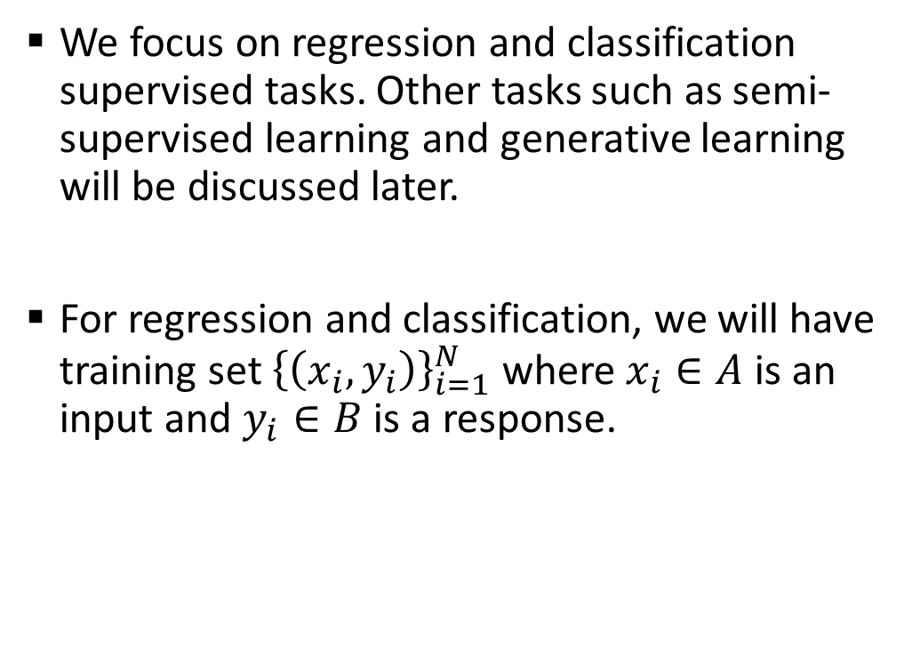
Inference Task
We focus on regression and classification supervised tasks. Other tasks such as semi-supervised learning and generative learning will be discussed later.
For regression and classification, we will have training set ${\left\{\left(x_{i},y_{i}\right)\right\}}_{i=1}^{N}$ where $x_{i}∈A$ is an input and $y_{i}∈B$ is a response.
Our goal is to learn a function $f:A→B$ such that
$$y_{i}=f\left(x_{i}\right).$$
$B=ℝ^{n}$ for regression
$B=\{1,…,K\}$ for classification

Slide 5

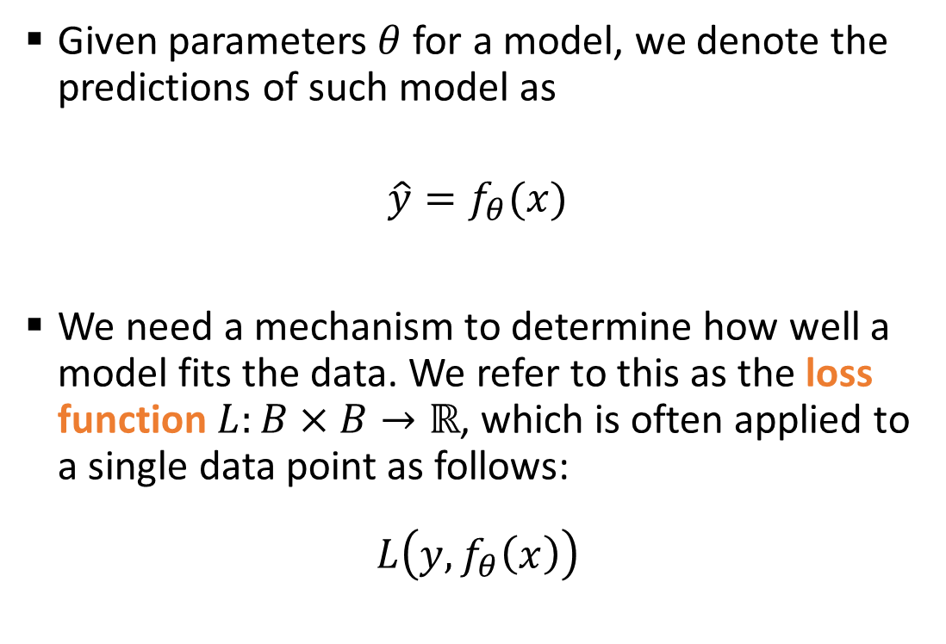




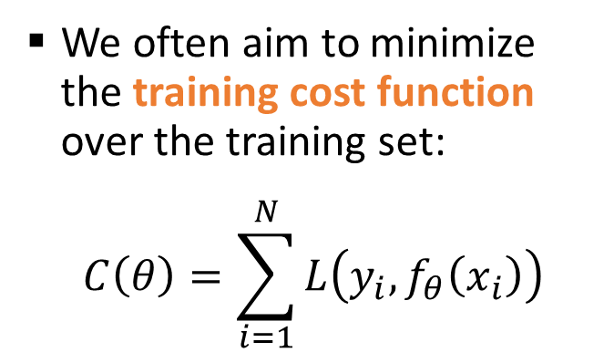

Training
Training
Given parameters $θ$ for a model, we denote the predictions of such model as
$$\hat{y}=f_{θ}(x)$$
We need a mechanism to determine how well a model fits the data. We refer to this as the loss function $L:B×B→ℝ$, which is often applied to a single data point as follows:
$$L\left(y,f_{θ}\left(x\right)\right)$$
$$x_{i}$$
$${\hat{y}}_{i}$$
Model $f_{θ}$
$$y_{i}$$
$$C$$
$$Loss$$
We often aim to minimize the training cost function over the training set:
$$C\left(θ\right)=\sum_{i=1}^{N}{L\left(y_{i},f_{θ}\left(x_{i}\right)\right)}$$
Notes:
`

Slide 6
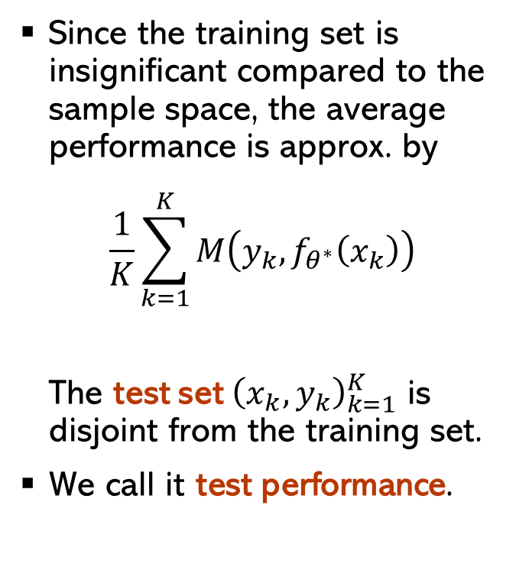
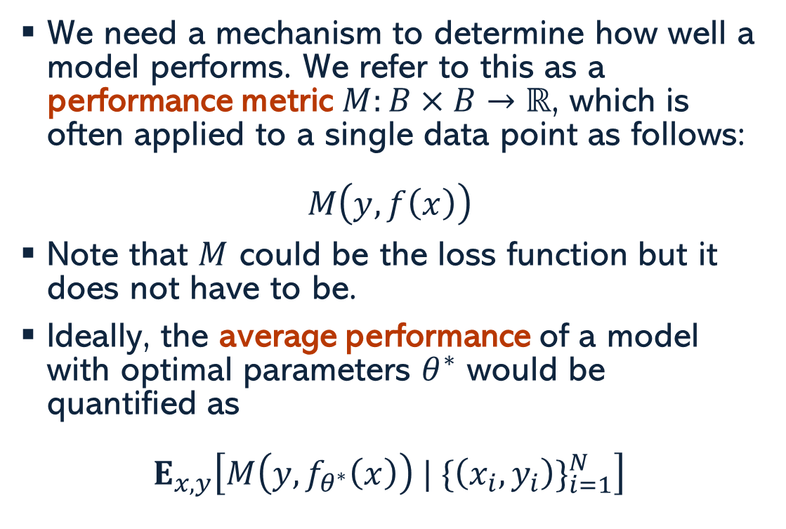
Testing or Evaluation
We need a mechanism to determine how well a model performs. We refer to this as a performance metric $M:B×B→ℝ$, which is often applied to a single data point as follows:
$$M\left(y,f\left(x\right)\right)$$
Note that $M$ could be the loss function but it does not have to be.
Ideally, the average performance of a model with optimal parameters $θ^{∗}$ would be quantified as
$$E_{x,y}\left[M\left(y,f_{θ^{∗}}\left(x\right)\right) | {\{\left(x_{i},y_{i}\right)\}}_{i=1}^{N}\right]$$
Since the training set is insignificant compared to the sample space, the average performance is approx. by
$$\frac{1}{K}\sum_{k=1}^{K}{M\left(y_{k},f_{θ^{∗}}\left(x_{k}\right)\right)}$$
The test set ${\left(x_{k},y_{k}\right)}_{k=1}^{K}$ is disjoint from the training set.
We call it test performance.

Slide 7
Model Selection with Big Data
It is possible to use a performance metric for model selection (e.g., linear fits of polynomials with different degrees). Choosing the test set for model selection introduces a dependency on the test samples. This results on a biased estimate of performance, i.e., performance is worse on new data.
When there is enough data, the solution is to create a separate validation set from the training data and use that for model selection (e.g., to select the hyper-parameters of a model)
Training – 85%
Pre-Val Training 70%
Validation
15%
Testing – 15%

Slide 8
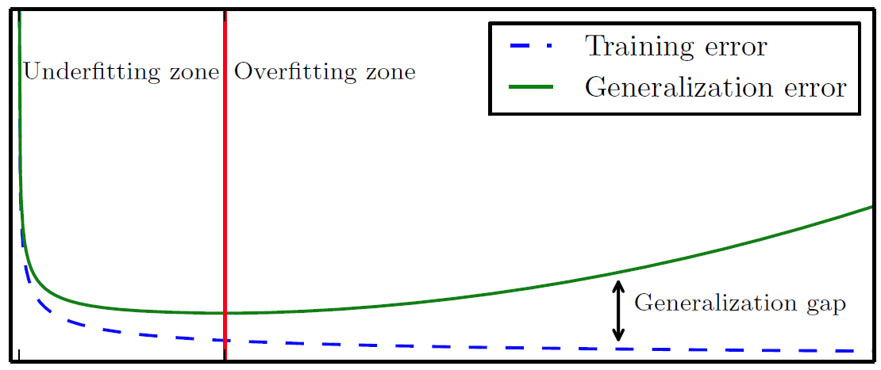
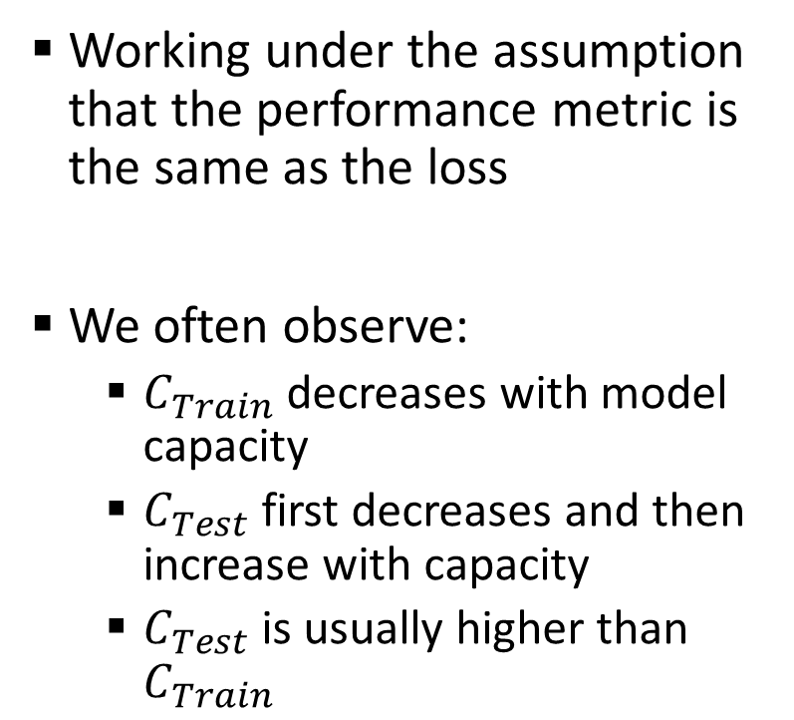


Overfitting vs. Underfitting
Cost
Working under the assumption that the performance metric is the same as the loss
We often observe:
$C_{Train}$ decreases with model capacity
$C_{Test}$ first decreases and then increase with capacity
$C_{Test}$ is usually higher than $C_{Train}$
Training Cost, $C_{Train}$
Underfitting Zone
Overfitting Zone
Test Performance, $C_{Test}$
Generalization Gap
Optimal Capacity
Model Capacity

Slide 9
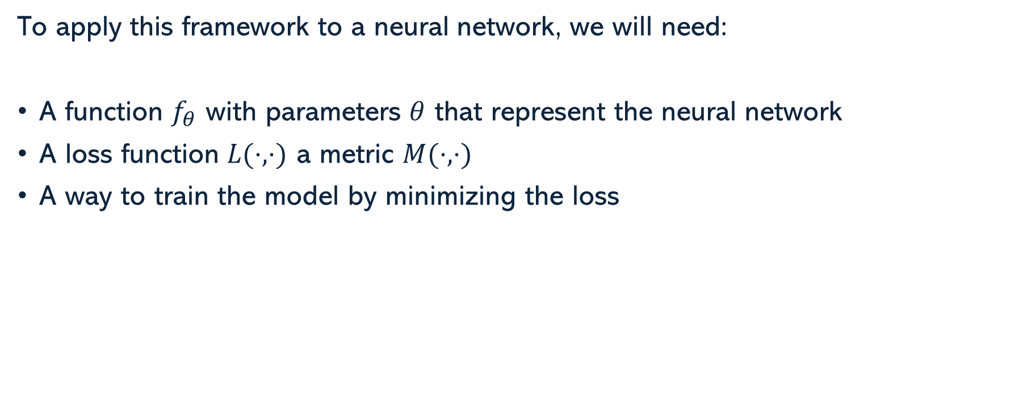
What do we need?
To apply this framework to a neural network, we will need:
A function $f_{θ}$ with parameters $θ$ that represent the neural network
A loss function $L(⋅,⋅)$ a metric $M(⋅,⋅)$
A way to train the model by minimizing the loss

Slide 10
Neural Nets Architecture

Slide 11
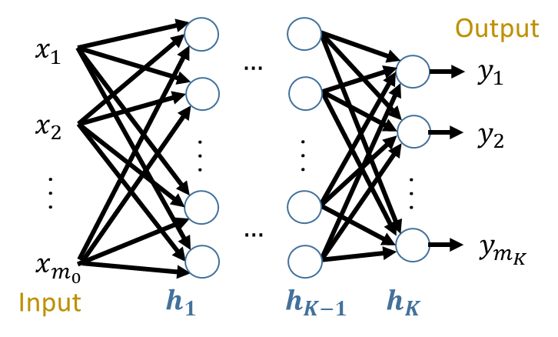
Neural Nets Architecture
A standard neural network with neurons fully connected between layer is known as a Fully Connected Network (FCN) or Multi-Layer Perceptron (MLP).
They form a Directed Acyclic Graphs (DAG)
For the first layer we have
$$h_{1}=g_{1}∘A_{1}\left(x\right)=g_{1}\left(W_{1}x+b_{1}\right)$$
After that we have
$$h_{k}=g_{k}∘A_{k}\left(h_{k−1}\right)=g_{k}\left(W_{k}h_{k−1}+b_{k}\right)$$
$h_{k}∈ℝ^{m_{k}}$, $x∈ℝ^{m_{0}}$, $y∈ℝ^{m_{K}}$, $g_{k}:ℝ^{m_{k}}→ℝ^{m_{k}}$,
$W_{k}∈ℝ^{m_{k}×m_{k−1}}$, $b_{k}∈ℝ^{m_{k}}$, $m_{k}$ is the layer width

Slide 12
Neural Nets Architecture
This gives the expression
$$\hat{y}=f_{θ}\left(x\right)=g_{K}∘A_{K}∘g_{K−1}∘…∘g_{1}∘A_{1}\left(x\right)$$
where $A_{k}:ℝ^{m_{k−1}}→ℝ^{m_{k}}$ is an affine transformation, and $g_{k}$ are non-linear activation functions, and $θ=\{b_{k},W_{k}\}$ are the parameters.
When training a model, we consider a cost of the form
$$C\left(θ\right)=\sum_{i}{L_{y_{i}}(f_{θ}\left(x_{i}\right))}+λ⋅Ω(θ)$$
where $Ω\left(θ\right)$ is some type of regularization term, and $λ$ is a hyper-parameter.

Slide 13
Loss Function

Slide 14
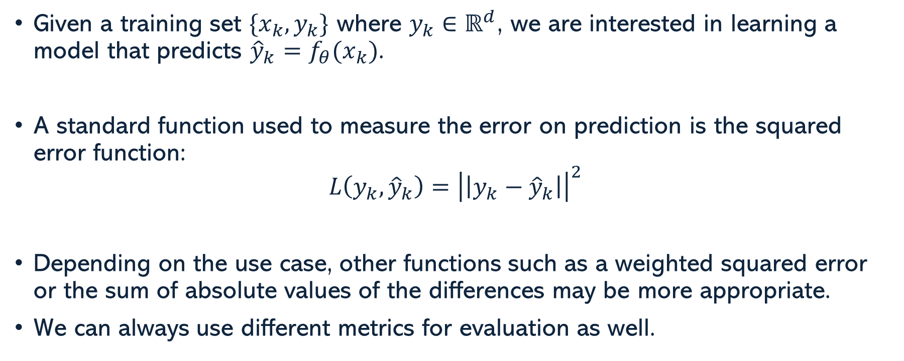
Regression Task
Given a training set $\{x_{k},y_{k}\}$ where $y_{k}∈ℝ^{d}$, we are interested in learning a model that predicts ${\hat{y}}_{k}=f_{θ}(x_{k})$.
A standard function used to measure the error on prediction is the squared error function:
$$L\left(y_{k},{\hat{y}}_{k}\right)={\left|\left|y_{k}−{\hat{y}}_{k}\right|\right|}^{2}$$
Depending on the use case, other functions such as a weighted squared error or the sum of absolute values of the differences may be more appropriate.
We can always use different metrics for evaluation as well.

Slide 15
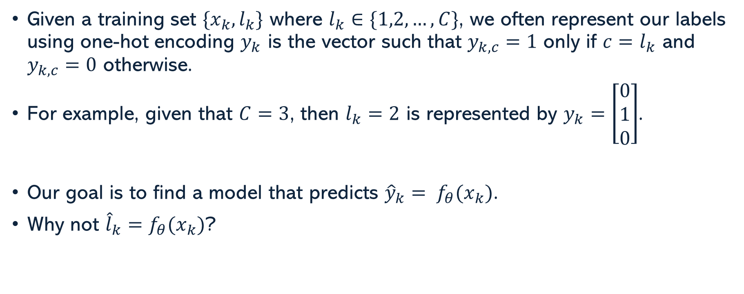
Classification Task
Given a training set $\{x_{k},l_{k}\}$ where $l_{k}∈\{1,2,…,C\}$, we often represent our labels using one-hot encoding $y_{k}$ is the vector such that $y_{k,c}=1$ only if $c=l_{k}$ and $y_{k,c}=0$ otherwise.
For example, given that $C=3$, then $l_{k}=2$ is represented by $y_{k}=\left[\begin{matrix}0 \\ 1 \\ 0\end{matrix}\right]$.
Our goal is to find a model that predicts ${\hat{y}}_{k}= f_{θ}(x_{k})$.
Why not ${\hat{l}}_{k}=f_{θ}(x_{k})$?

Slide 16
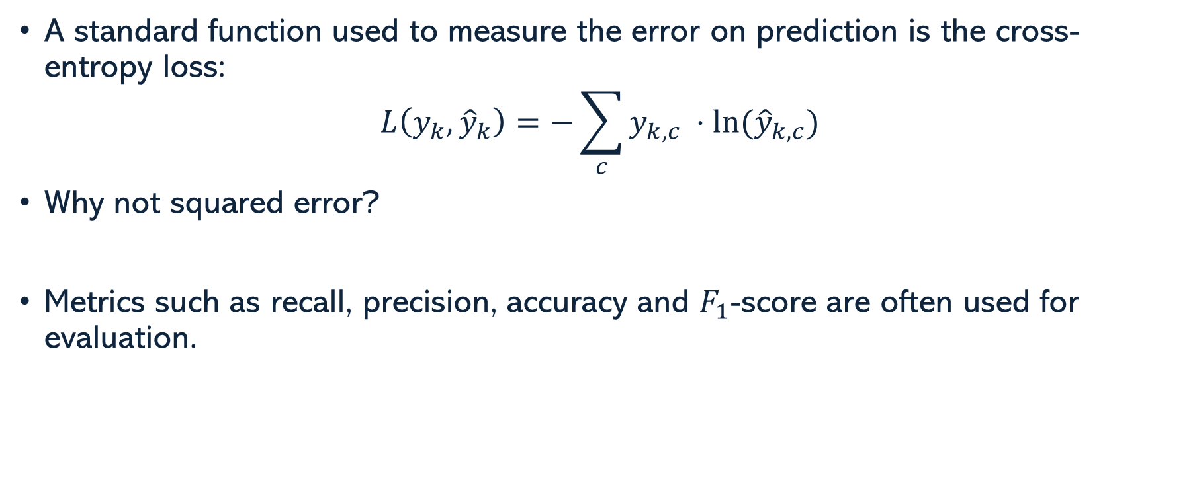
Classification Task
A standard function used to measure the error on prediction is the cross-entropy loss:
$$L\left(y_{k},{\hat{y}}_{k}\right)=−\sum_{c}{y_{k,c} ⋅ln⁡({\hat{y}}_{k,c})}$$
Why not squared error?
Metrics such as recall, precision, accuracy and $F_{1}$-score are often used for evaluation.

Slide 17
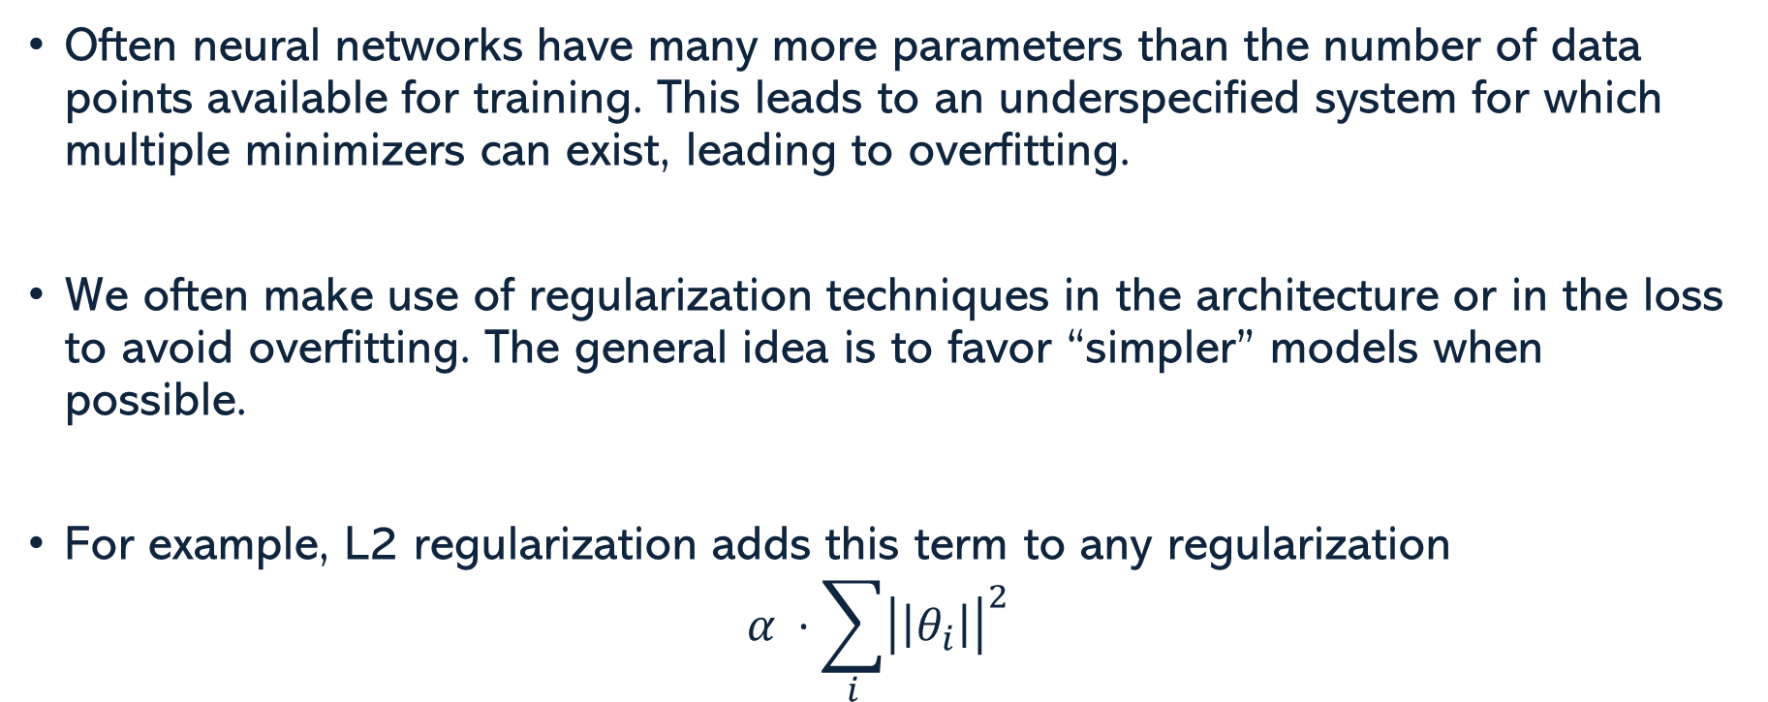
Regularization Terms
Often neural networks have many more parameters than the number of data points available for training. This leads to an underspecified system for which multiple minimizers can exist, leading to overfitting.
We often make use of regularization techniques in the architecture or in the loss to avoid overfitting. The general idea is to favor “simpler” models when possible.
For example, L2 regularization adds this term to any regularization
$$α ⋅\sum_{i}{{\left|\left|θ_{i}\right|\right|}^{2}}$$

Slide 18
Gradient Descent

Slide 19
Gradient Descent
$$C$$
A first order method uses the gradient to take a step of a given length on the direction that reduces the function.
Given a cost function (e.g., a loss) $C$ for a set of parameter $θ$, the update rule for first order methods is $θ^{(k+1)}=θ^{\left(k\right)}−ε⋅\frac{dC}{dθ}{\left(θ\right)}^{⊤}$, where $ε$ is referred to as the learning rate.
$$C(θ)$$
$$θ$$
$$θ^{(0)}$$
$$θ^{\left(1\right)}$$

Slide 20
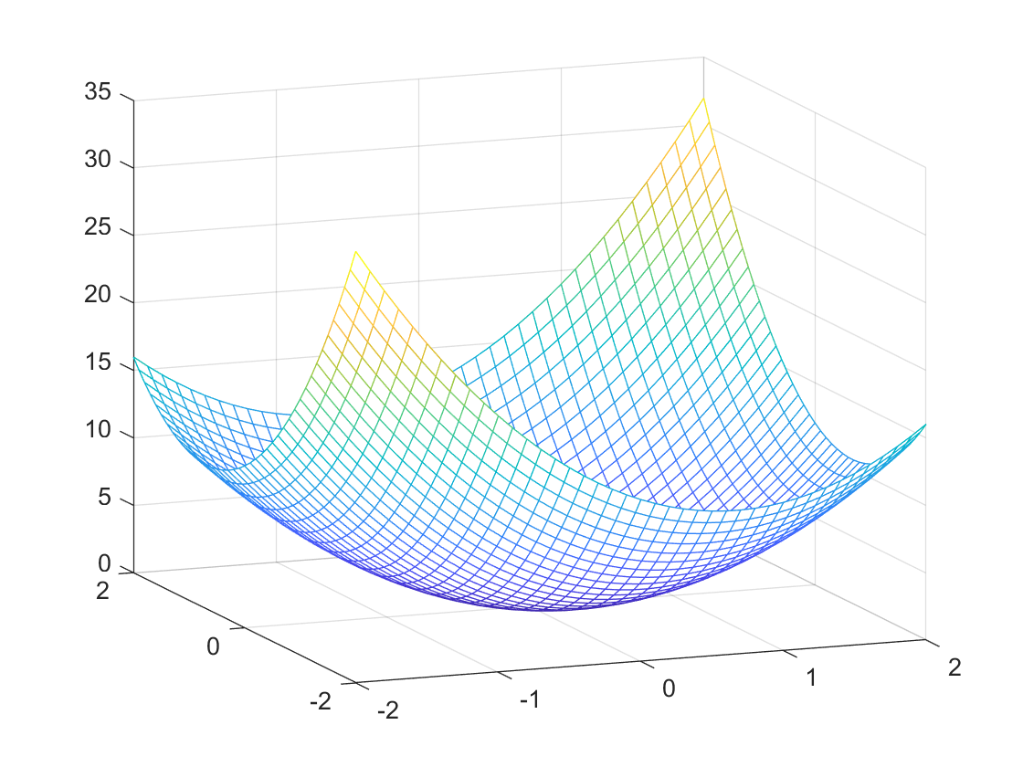
Gradient Descent
Function Minimization:
$ε$ too large
$ε$ about right
$$θ^{\left(1\right)}$$
$$θ^{\left(1\right)}$$
$$θ^{\left(2\right)}$$
$$θ^{\left(3\right)}$$
$$θ_{2}$$
$$θ^{\left(3\right)}$$
$$θ^{\left(0\right)}$$
$$θ^{\left(2\right)}$$
$$θ^{\left(0\right)}$$
$$−\frac{dC}{dθ}\left(θ^{\left(0\right)}\right)$$
$$θ_{2}$$
$$θ_{1}$$
$$θ_{1}$$

Slide 21
Stochastic Gradient Descent (SGD)
A Deep Neural Network’s large amount of data can be challenging to process
The basic approach using full data is referred to as Batch Gradient Descent
SGD uses Mini-Batches
Using a Mini-Batch provides a faster convergence
Randomized gradient has some benefits
$$θ^{\left(2\right)}$$
$$θ^{\left(3\right)}$$
$$θ^{\left(0\right)}$$
$$θ^{\left(1\right)}$$

Slide 22
Stochastic Gradient Descent (SGD)
Making a pass through the entire data using mini-batches is known as an epoch of training
Variants of SGD include:
SGD with Momentum
Adam Optimizer

Slide 23
Backpropagation

Slide 24
Forward & Backpropagation
Forward propagation refers to the process of evaluating a neural network from input to output. This just requires standard evaluation of the functions defined at each neuron.
Backpropagation refers to the process of computing the derivatives of the loss function starting on the output and ending at the input. This is done in reverse order for computational efficiency.
Backpropagation results in the multiplication of partial derivatives using the chain rule.

Slide 25
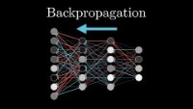
Backpropagation

Slide 26
Challenges

Slide 27
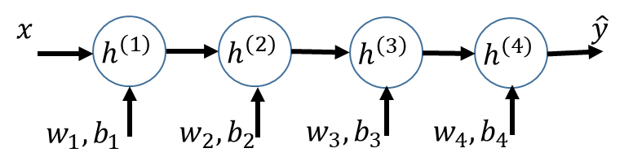
Vanishing / Exploding Gradients
ReLU
Consider a simple scalar network with
$$a^{\left(k\right)}=w_{k}⋅h^{\left(k−1\right)}+b_{k} ; h^{\left(k\right)}=g\left(a^{\left(k\right)}\right)$$
Initialize $w,b \sim N(0,1)$
Sigmoid
Then,
$$\frac{dL_{y}}{db_{1}}\left(w,b \right)=\frac{dL_{y}}{d\hat{y}}\left(h^{\left(4\right)}\right)⋅g^{′}\left(a^{\left(4\right)}\right)⋅w_{4}⋅g^{′}\left(a^{\left(3\right)}\right)⋅w_{3}⋅g^{′}\left(a^{\left(2\right)}\right)⋅w_{2}⋅g^{′}\left(a^{\left(1\right)}\right)$$
Notes:
The issue of vanishing gradients is caused by the derivatives of the sigmoid been small and mostly zero. ReLu reduces that effect. However, if the weights end up being large then we can have an exploiting gradient.

Slide 28




Thank you
Edgar Lobaton
edgar.lobaton@ncsu.edu
https://research.ece.ncsu.edu/aros/

